Slide 1
PowerCLI Lint
CODE5540U
How to start writing better code
Justin P. Sider
@jpsider
http://www.invoke-automation.blog
Chief Information Officer – Belay Technologies
#vmworld #code5540u

Slide 2

Got Lint?

Slide 3
Agenda
What’s Linting? It sounds gross!
Unit Testing
The Standard PowerShell tools
PSScriptAnalyzer
Pester
PSCodeHealth
Easy to Read, Reusable Code
The Goal

Slide 4
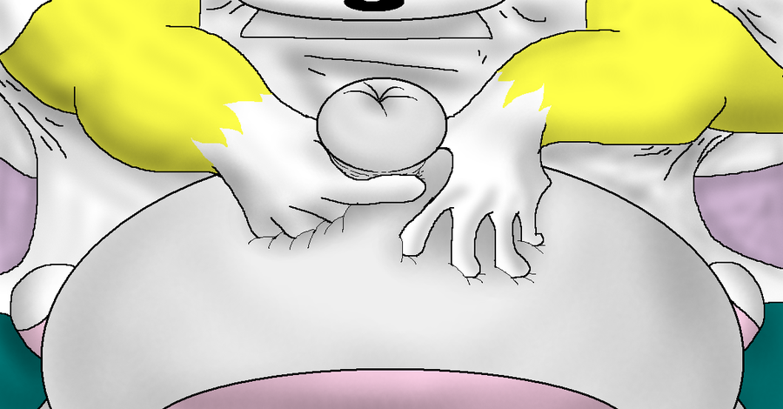
What’s Linting? It sounds gross!
Identifies:
Styling issues
Violations of best practices
Comment based help exists
Code Complexity
This is a skill, the process is iterative, be patient! It will pay off!
https://github.com/PoshCode/PowerShellPracticeAndStyle
Unofficial
Guide

Slide 5
Styling Issues
Everyone wants the best “1 liner” in the world….
$vm = Get-VM -VM "SomeName"
if($vm -eq $null) { Write-Host "No VM found" } else {Write-Host "Oh, Hey The VM exists!"}
More Lines are easier to read!
$vm = Get-VM -VM "SomeName"
if($null -eq $vm)
{
Write-Output "No VM found"
}
else
{
Write-Output "Oh, Hey The VM exists!"
}
Did you catch the other changes I made?
$null should be on the left side of equality comparisons.
Do Not use Write-Host
I hate this rule!
And this one!

Slide 6


Best Practices
See anything wrong with this?
Get-VM | % { Start-VM }
Do Not Use Aliases!
Get-VM | % { Start-VM }
Get-VM | ForEach-Object { Start-VM }
Technically both are correct. However the one on the bottom is easier to read.
VScode will highlight these for you!

Slide 7
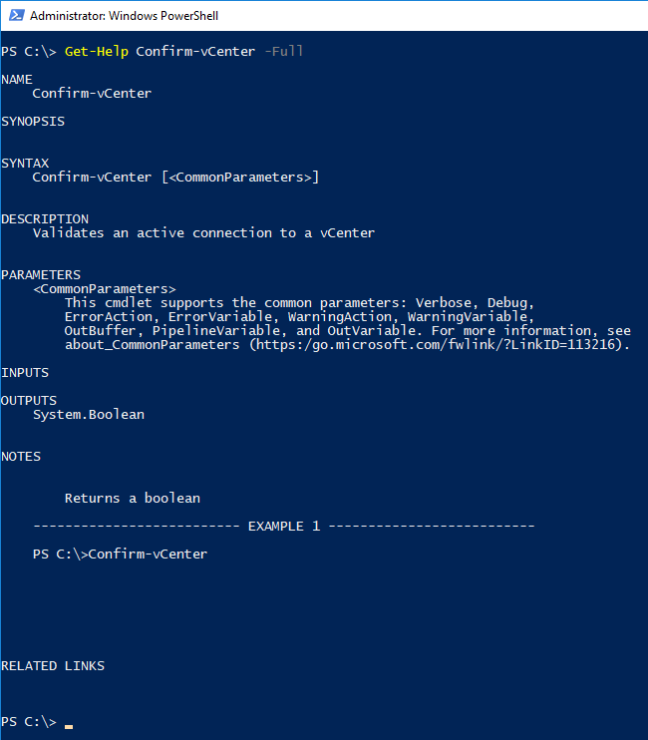
Comment Based Help
First things first…..
1 Function per File.
Second, add help!
<#
.DESCRIPTION
Validates an active connection to a vCenter
.EXAMPLE
Confirm-vCenter
.NOTES
Returns a boolean
#>
Just a few lines can be very helpful!

Slide 8
Code Complexity
Can you solve the problem with less code?
$Cluster = Get-Cluster
if ($Cluster = "Production") {
Write-Output "Do Production Stuff"
} elseif ($Cluster = "Pre-Prod") {
Write-Output "Do Pre-Prod Stuff"
} elseif ($Cluster = "Development") {
Write-Output "Do Development Stuff"
} elseif ($Cluster = "Infrastructure") {
Write-Output "Do Infrastructure Stuff"
} else {
Write-Output "Cluster Not found"
}
$Cluster = Get-Cluster
switch ($Cluster) {
Production { Write-Output "Do Production Stuff" }
Pre-Prod { Write-Output "Do Pre-Prod Stuff" }
Development { Write-Output "Do Development Stuff" }
Infrastructure { Write-Output "Do Infrastructure Stuff" }
Default { Write-Output "Cluster Not found" }
}
Reducing Code complexity makes Unit Testing a breeze! Nested If-Then statements make code very difficult to maintain. Break those up into multiple functions when possible.
I know I cheated on the line spacing.

Slide 9
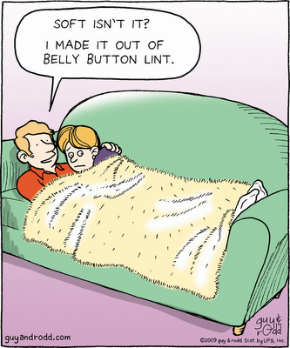
Unit Testing
What is it?
Why would you want it?
What’s Code Coverage?

Slide 10
What is Unit Testing?
It’s a process in which the smallest testable parts of your code are individually and independently scrutinized for proper operation.
Or…….. Your code does what it says. Each and Every time.
Example Code:
Param (
[Parameter(Mandatory)]$VM,
[Parameter()][string]$PowerState = "PoweredOff"
)
if ($VM.PowerState -eq "$PowerState"){
$true
} else {
$false
}
Example Test:
Describe "Confirm-PowerState function" {
$VMdata = @{
'Name' = "SomeVM"
'PowerState' = 'PoweredOff'
'Num CPUs' = '1'
'MemoryGB' = '2.000'
}
$returnData = $VMdata | ConvertTo-Json
$VMname = $returnData | ConvertFrom-Json
It "Should return True if the PowerState matches the desired value." {
Confirm-PowerState -VM $VMname | Should be $true
}
}
Set Up a fake VM Object
Execute the test with the fake object
If the PowerStates match, the test passes

Slide 11
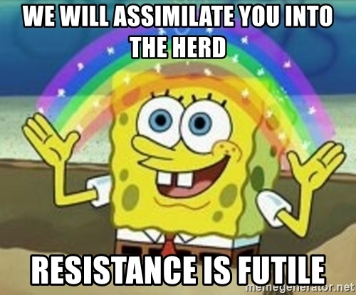
Why you should Unit Test your code.
We all make mistakes.
It will force you to write better code.
It will force you to break your code into smaller pieces.
You will be able to reuse more of your code.
You will be more confident in your code.
You will like coding/scripting even more
You will like unit testing…...
You will like unit testing…...

Slide 12
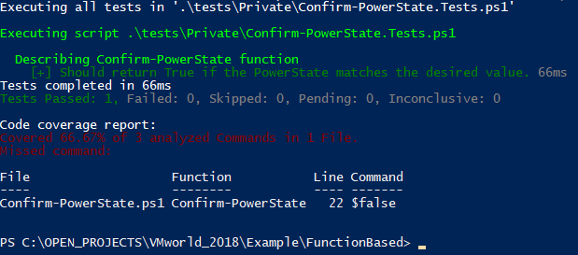
Code Coverage
Ensure that all of your script ‘Paths’ or script decisions are tested. The test from the previous slide only tested if the PowerState’s match. Should you always have 100% coverage? It’s a personal preference.
Invoke-Pester -Script .\tests\Private\Confirm-PowerState.Tests.ps1 -CodeCoverage .\Private\Confirm-PowerState.ps1
Pester has a Parameter to determine Code Coverage
It tells you which commands and lines were not tested.

Slide 13
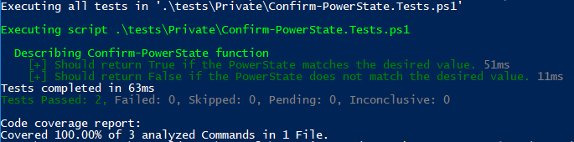
Code Coverage, cont.
Describe "Confirm-PowerState function" {
$VMdata = @{
'Name' = "SomeVM"
'PowerState' = 'PoweredOff'
'Num CPUs' = '1'
'MemoryGB' = '2.000'
}
$returnData = $VMdata | ConvertTo-Json
$VMname = $returnData | ConvertFrom-Json
It "Should return True if the PowerState matches the desired value." {
Confirm-PowerState -VM $VMname | Should be $true
}
It "Should return False if the PowerState does not match the desired value.“ {
Confirm-PowerState -VM $VMname -PowerState "PoweredOn" | Should be $false
}
}
Ensure that all of your script ‘Paths’ or script decisions are tested. The test from the previous slide only tested if the PowerState’s match.
1
2
New Test, where the PowerStates will not match
With the New test, we have 100% of the code covered with unit tests.

Slide 14
The Standard PowerShell Tools
PSScriptanalyzer
Pester
PSCodeHealth
All of these Tools are Modules available in the PowerShell Gallery
Install-Module -Name PSScriptAnalyzer, Pester, PSCodeHealth

Slide 15
PSScriptAnalyzer
How do you run it?
Single File:
Invoke-ScriptAnalyzer -Path .\Private\Confirm-vCenter.ps1
Directory/Tree:
Invoke-ScriptAnalyzer -Path . -Recurse
If there are no findings, there is no Output!
The Module is on GitHub, and there is a very active channel on the PowerShell Slack.
https://github.com/PowerShell/PSScriptAnalyzer
Join Slack here:
http://slack.poshcode.org/

Slide 16
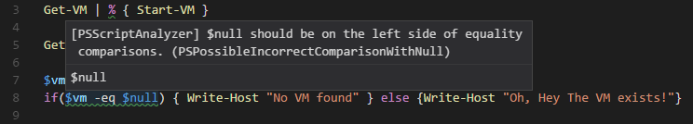
PSScriptAnalyzer con’t
VScode Integration
What a Failure or Finding looks like:

Slide 17
PSScriptAnalyzer cont.
This is a valid variable with PowerCLI
How to ignore items that you cannot avoid.
Simply add a line, to the function file, not the test file, to suppress the warning:
[Diagnostics.CodeAnalysis.SuppressMessageAttribute("PSAvoidGlobalVars",'')]

Slide 18
Pester
The best ‘Getting Started’ with Pester documentation I’ve ever read was in the PowerShell Conference Book. The chapter was written by Mark Wragg.
https://leanpub.com/powershell-conference-book
PowerShell’s solution for Unit Testing.
START SMALL!
This is where the ‘1 function, 1 file’
methodology will quickly make sense.
Example Code:
Param (
[Parameter(Mandatory)]$VM,
[Parameter()][string]$PowerState = "PoweredOff"
)
if ($VM.PowerState -eq "$PowerState"){
$true
} else {
$false
}
Example Test:
Describe "Confirm-PowerState function" {
$VMdata = @{
'Name' = "SomeVM"
'PowerState' = 'PoweredOff'
'Num CPUs' = '1'
'MemoryGB' = '2.000'
}
$returnData = $VMdata | ConvertTo-Json
$VMname = $returnData | ConvertFrom-Json
It "Should return True if the PowerState matches the desired value." {
Confirm-PowerState -VM $VMname | Should be $true
}
}
Set Up a fake VM Object
Execute the test with the fake object
If the PowerStates match, the test passes

Slide 19
PSCodeHealth
Combines PSScriptAnalyzer and Pester, then makes pretty pictures!
Example:
$PSCodeHealthParameters = @{
Path = ".\FunctionBased\$Directory\"
TestsPath = ".\FunctionBased\tests\$Directory\"
HtmlReportPath = "$BaseDir\vmworldReport_$Directory.html"
PassThru = $true
}
Invoke-PSCodeHealth @PSCodeHealthParameters
https://pscodehealth.readthedocs.io/en/latest/
This is called Splatting

Slide 20
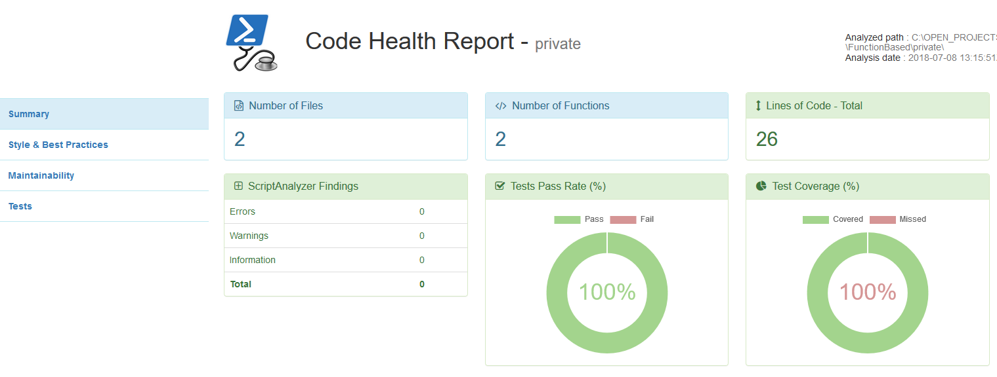
Example PSCodeHealth Report

Slide 21
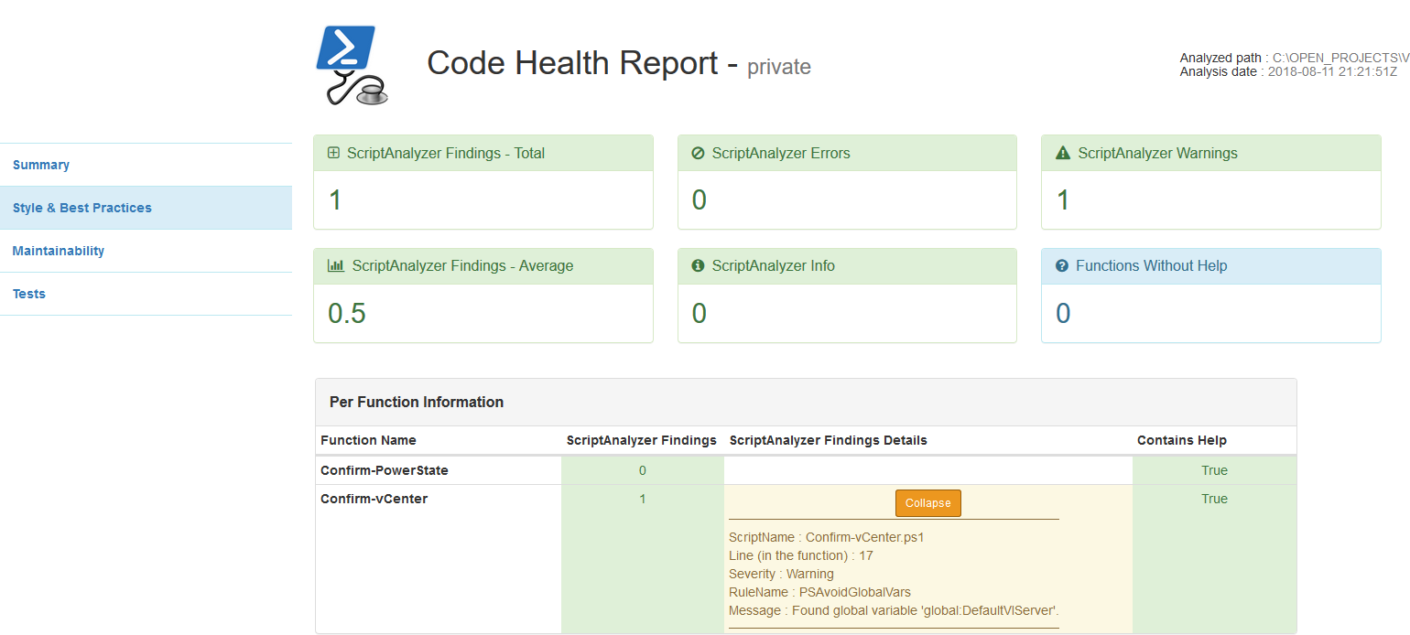
PSCodeHealth Cont.
Style & Best Practice Report:
Highlights
Details

Slide 22
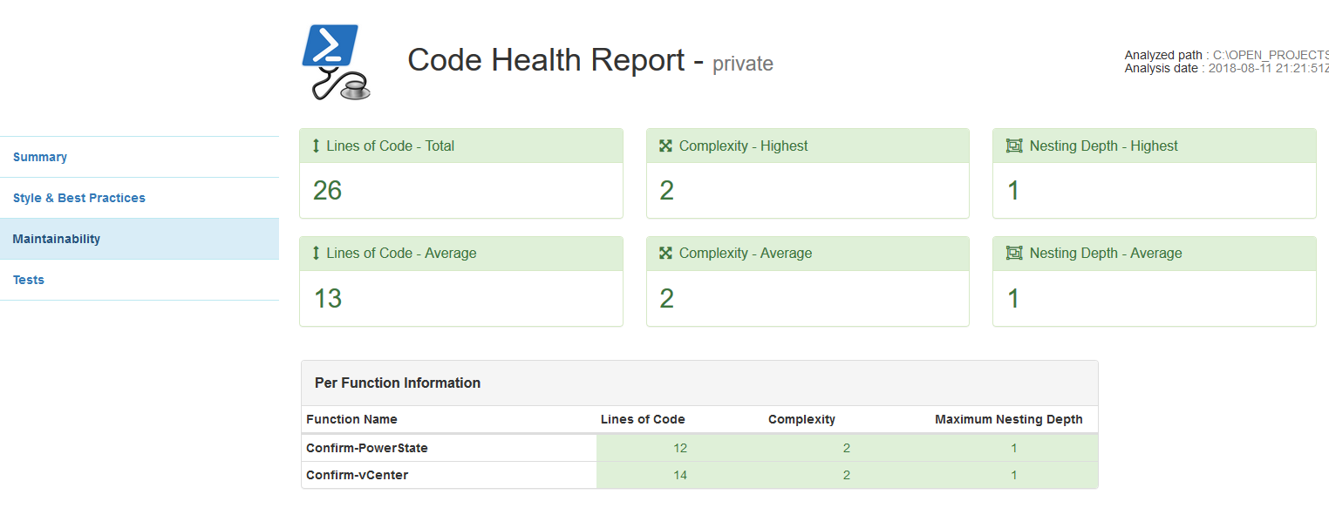
PSCodeHealth Cont.
Useful Data
Maintainability (Complexity):

Slide 23
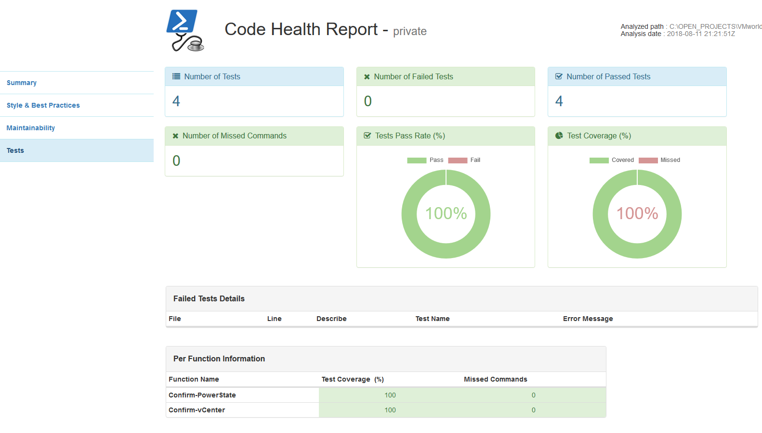
PSCodeHealth Cont.
Unit Testing
Great Summary
Fancy Charts!
Function by Function Breakdown

Slide 24

That’s a Wrap!
Code for this presentation available here:
https://github.com/jpsider/VMworld_2018
Feel free to Reach out to me directly.
Jpsider - (Twitter, GitHub, Slack, pretty much have this name everywhere)
http://invoke-automation.blog
http://belaytech.com
https://leanpub.com/powershell-conference-book
Special thanks to the VMware {Code} team for their hard work
putting on such a valuable and rewarding event for the community.

Slide 25
PLEASE FILL OUT YOUR SURVEY.
Take a survey and enter a drawing for a VMware company store gift card.

Slide 26
THANK YOU!

